Slide 1
Simplifying ChatGPT: Efficient Document Querying with Azure OpenAI
Luca Zavarella

Slide 2
Sponsors & Organizers

Slide 3


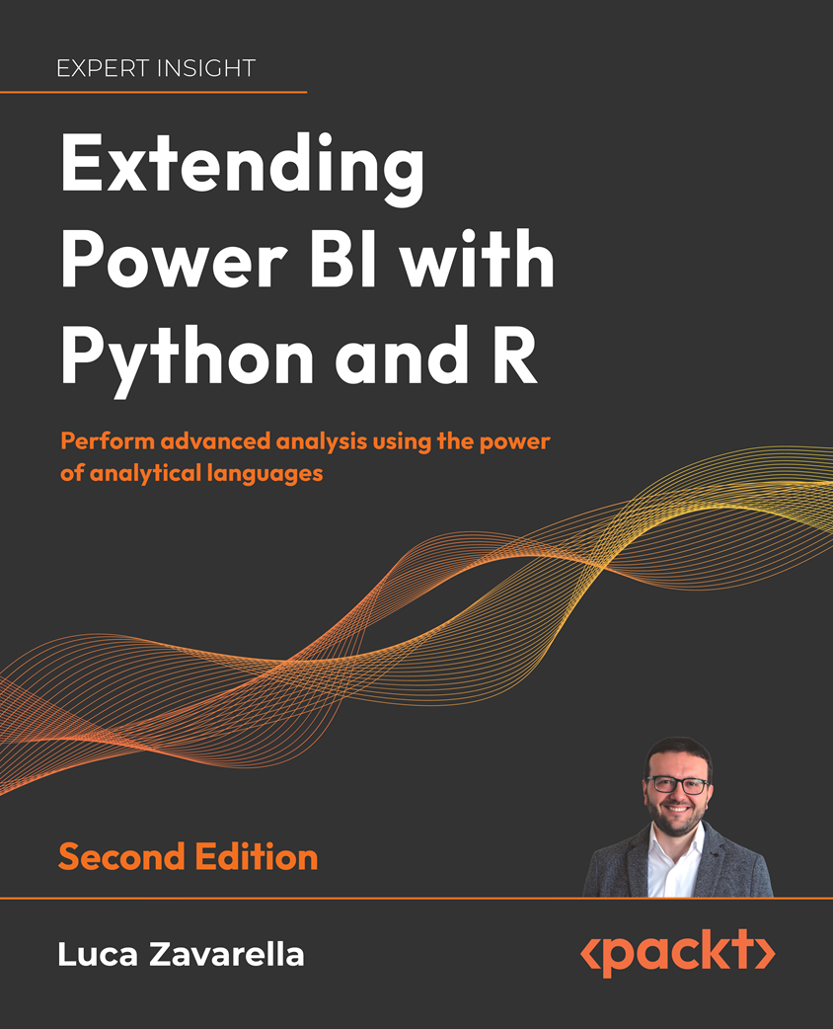
Luca Zavarella
Working in Business Intelligence with SQL Server since 2007
Microsoft Data Platform MVP
Microsoft Certified: Azure Data Scientist Associate
Author of “Extending Power BI with Python and R, 2° Ed.” by Packt
Head of Data & AI @
Email: luca.zavarella@icubed.it
Twitter: @lucazav
LinkedIn: https://it.linkedin.com/in/lucazavarella
Blog: https://lucazavarella.medium.com

Slide 4
Agenda
What is ChatGPT and how does it work?
Why so much success?
Emergent Behavior Examples
Unlocking Business Potential with Prompt Engineering
DEMO 01 – Play with “Azure AI on Your Data”

Slide 5
What is ChatGPT and How Does it Work?

Slide 6


What is ChatGPT
AI chatbot developed by OpenAI
Software application
Uses Artificial Intelligence (AI) and Natural Language Processing (NLP) techniques
Comprehend customer queries and generate automated responses, creating a conversational experience like that of human interaction

Slide 7
ChatGPT Technology
Built on top of GPT family of Large Language Models (LLM)
Advanced AI systems designed to understand and generate human-like text based on the input they receive
Generative Pre-trained Transformers (GPT)
Can generate new and original data based on patterns it has learned during training
This contrasts with discriminative AI algorithms that can classify, or label data based on pre-defined categories

Slide 8
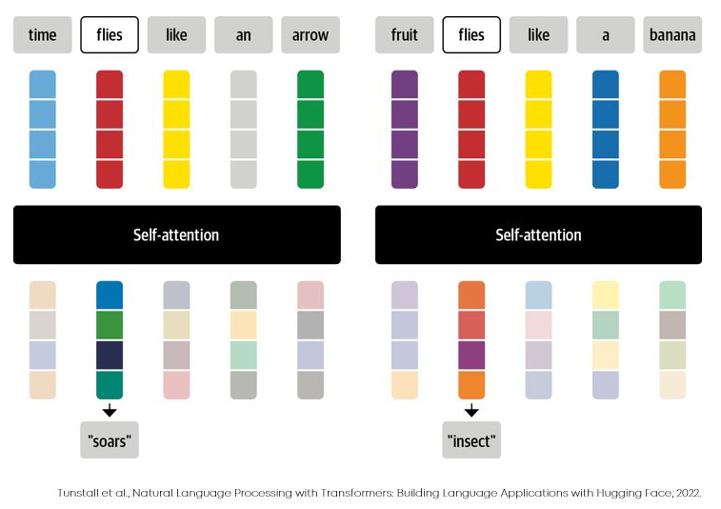
Transformer Foundation Model
A neural network that learns context and thus meaning by tracking relationships in sequential data like the words in this sentence
First described in a 2017 paper from Google (Attention Is All You Need)
They apply an evolving set of mathematical techniques, called attention or self-attention
They detect subtle ways even distant data elements in a series influence and depend on each other
Called “foundation models” because they drove a paradigm shift in AI
Notes:
RNNs are designed to take sequences of text as inputs or return sequences of text as outputs. They have difficulty in learning long sequences (Vanishing and Exploding Gradients).
Long short-term memory (LSTM) network is a recurrent neural network (RNN), aimed to deal with the vanishing gradient problem present in traditional RNNs. It aims to provide a short-term memory for RNN that can last thousands of timesteps, thus "long short-term memory“
(https://medium.com/@mroko001/rnn-vs-lstm-vs-transformers-unraveling-the-secrets-of-sequential-data-processing-c4541c4b09f)

Slide 9

What LLMs Really Do
They generate a coherent and plausible extension of the given text, based on the patterns and relationships it has learned from analyzing vast amounts of text data on the Internet and other sources
Provide a probability distribution over a sequence of words
They estimate the likelihood of each word or set of words appearing in each sentence or text

Slide 10
Randomness of ChatGPT Output
You may think to pick the highest-ranked word…
You will get a very “flat” essay
Never seems to show any “creativity” (and even sometimes repeats word for word)
“Temperature” parameter determines how often lower-ranked words will be used
The term "temperature" stems from its analogy with statistical mechanics and the Boltzmann distribution
A higher temperature (→1.0) increases the randomness and diversity of the output
A lower temperature (0 ←) reduces the randomness
For essay generation (“creativity”), it turns out that a “temperature” of 0.8 seems best

Slide 11
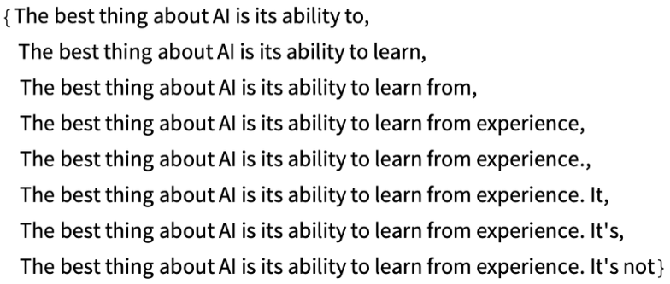
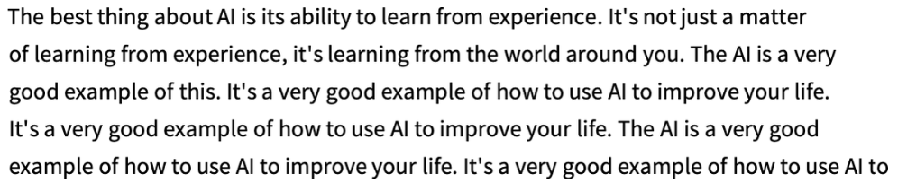
Text Generation Using Temperature 0.0

Slide 12
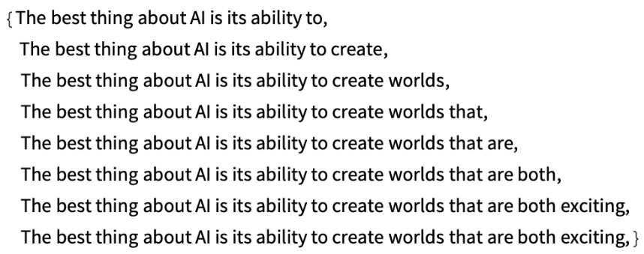
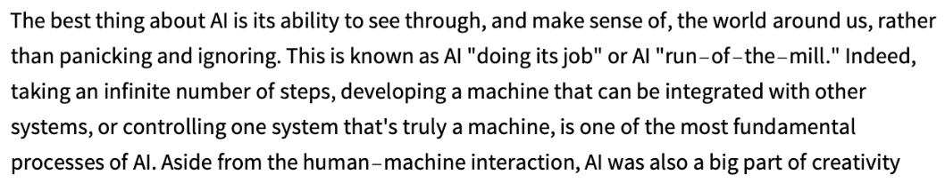
Text Generation Using Temperature 0.8

Slide 13
GPT Evolution With Numbers
OpenAI has been developing GPT since 2018
GPT-1
Trained with BooksCorpus dataset (5 GB), for language understanding
GPT-2
Launched on Valentine’s Day 2019 ☺
Trained with Reddit articles with over 3 likes (40 GB)
The training cost was $43,000
GPT-3
Released in June 2020
Trained by a much more comprehensive dataset
GPT-4
Released In March 2023
It has 175 billion parameters
It receives 10 million queries per day
Trained on ~ 570 GB of text datasets, including web pages, books, and other sources
Costs an estimated $12 mln to train
GPT-4o (“omni”)
Released on May 13, 2024
Provides GPT-4-level intelligence with improvements in speed and capabilities across text, voice, and vision
Features improved tokenization, particularly for non-Roman alphabets, enhancing efficiency and cost-effectiveness
Available for free to ChatGPT users, with higher usage limits for Plus and Enterprise users
Incorporates advanced tools like real-time video conversation, data analysis, and image-based discussions
Training cost is not explicitly mentioned but inferred to be significant due to the advanced capabilities and broader multimodal training data

Slide 14
Why so much success?

Slide 15
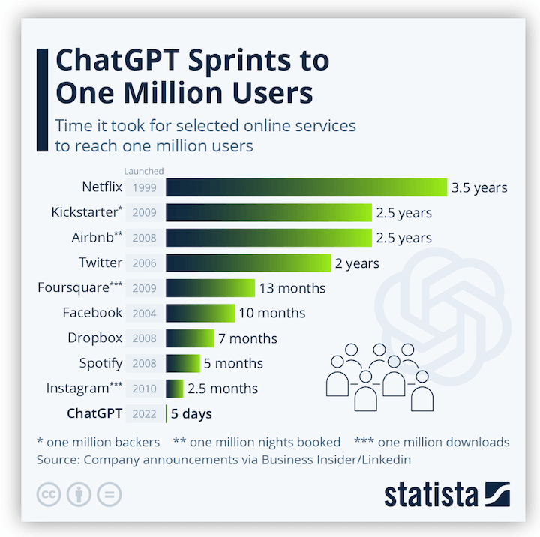
ChatGPT Has Gone Viral!

Slide 16
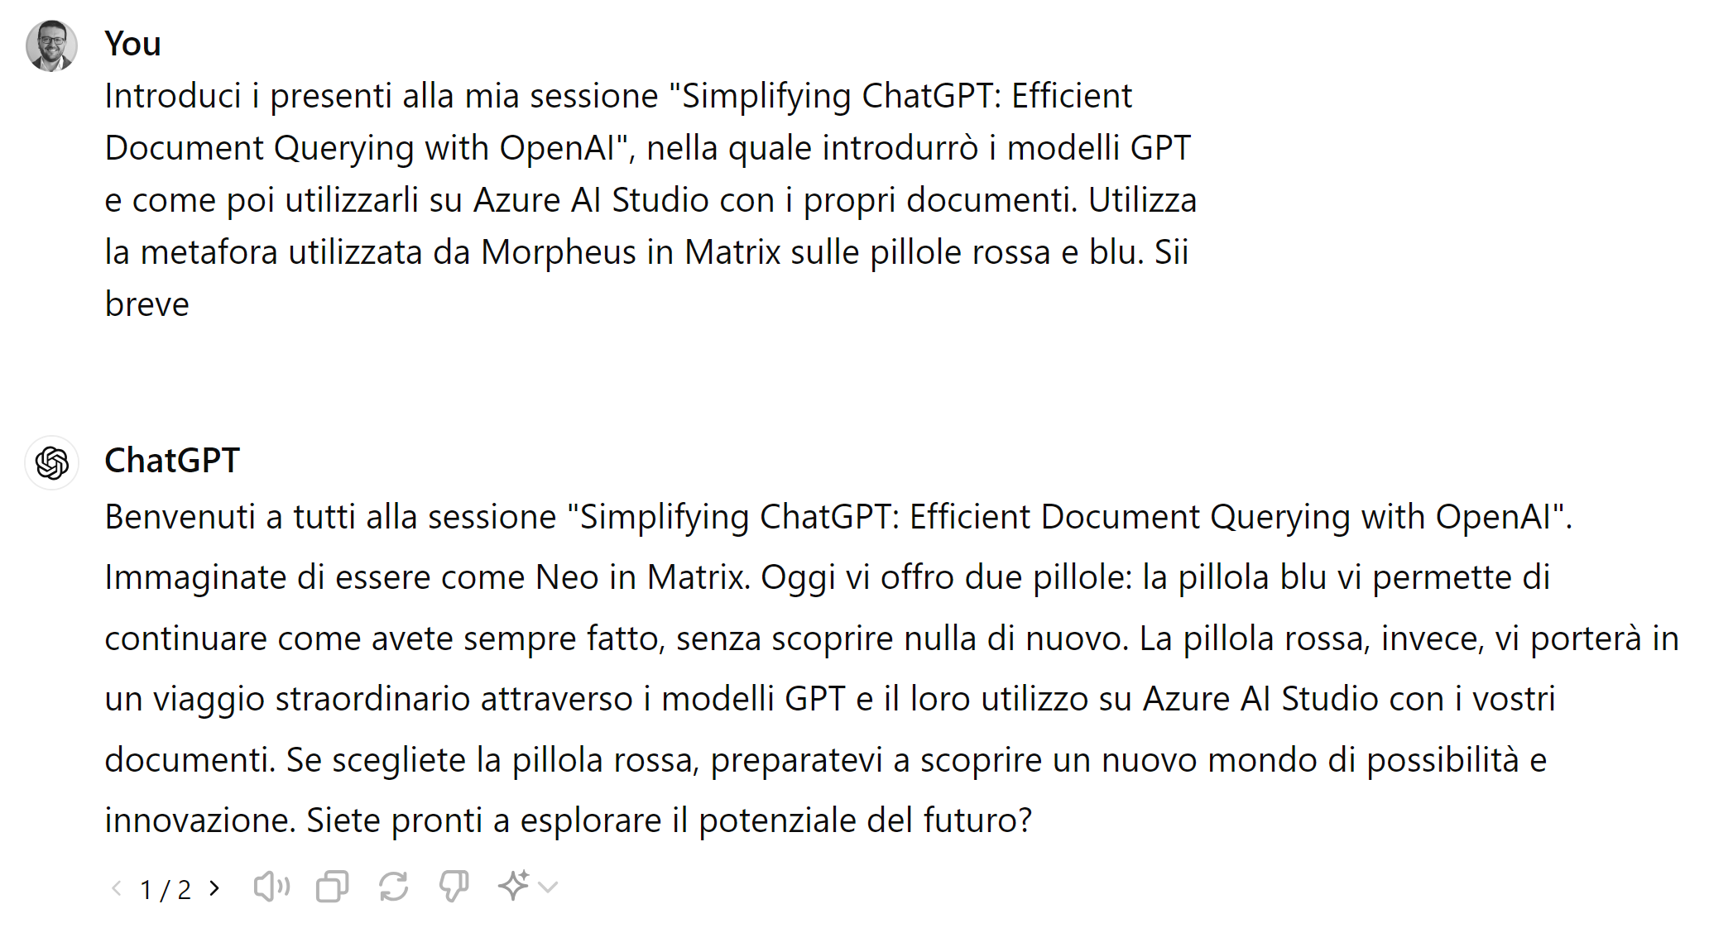
Why is it so successful? – 1/2
It is generative! 🤯

Slide 17
Why is it so successful? – 2/2
These models supposedly have one directive
To accept a string of text as input and predict what comes next, over and over, based purely on statistics
Computer scientists anticipated that scaling up would boost performance on known tasks
They didn’t expect the models to suddenly handle so many new unpredictable tasks (emergent behavior)! 😱
Abilities not present in smaller-scale models but are present in large-scale models
Thus, they cannot be predicted by simply extrapolating the performance improvements on smaller-scale models

Slide 18
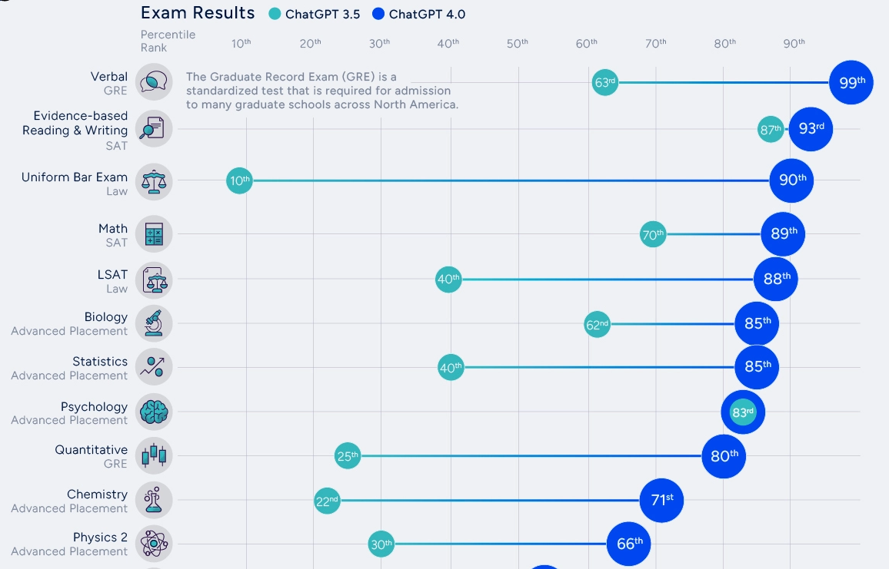
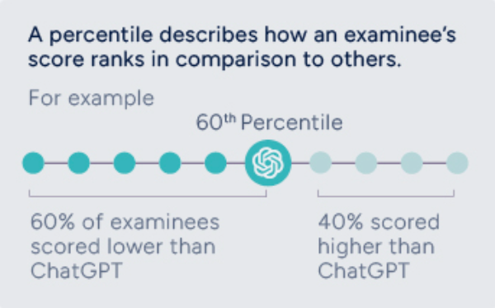
How Smart is ChatGPT?
https://www.visualcapitalist.com/how-smart-is-chatgpt/

Slide 19

The Magic of Complex Systems

Slide 20
Emergent Behavior Examples

Slide 21
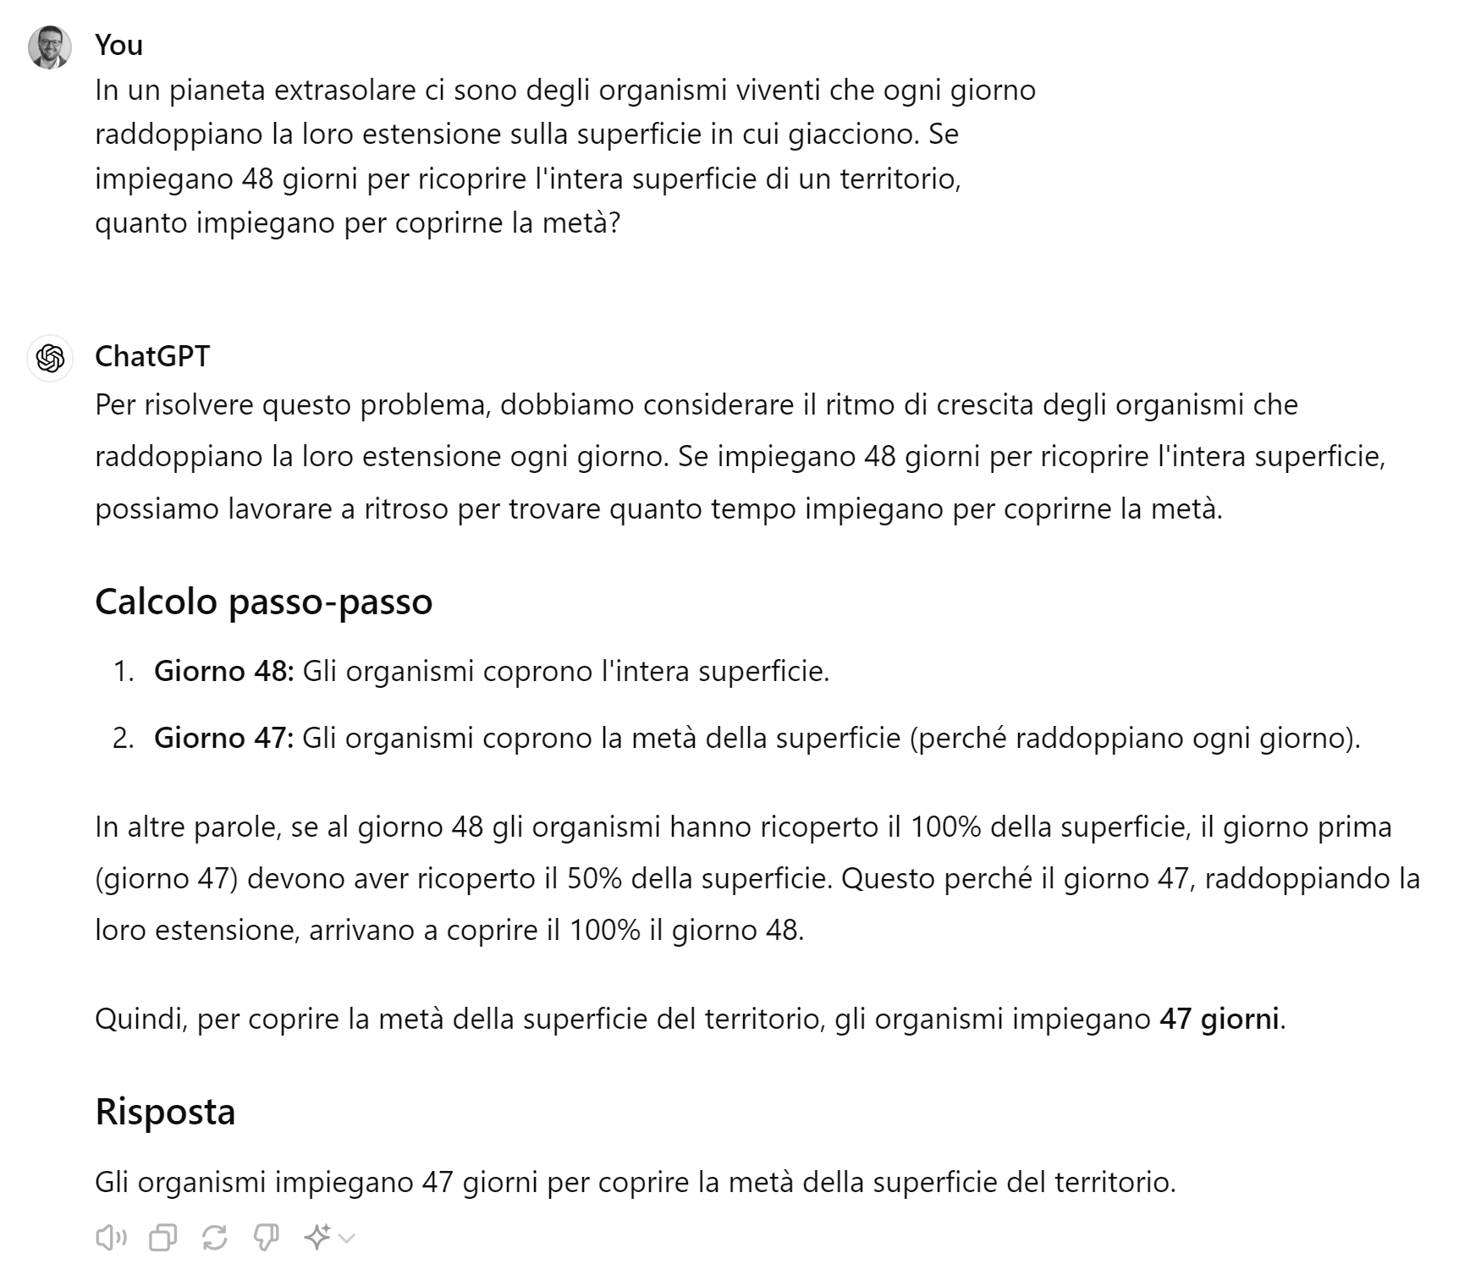
Advanced Problem Solving: Logical Riddles 1

Slide 22
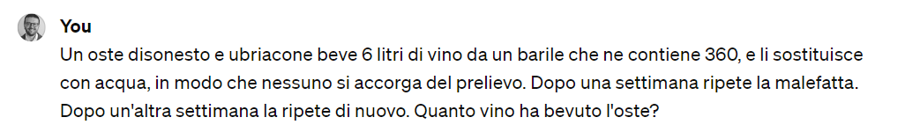
Advanced Problem Solving: Logical Riddles 2

Slide 23
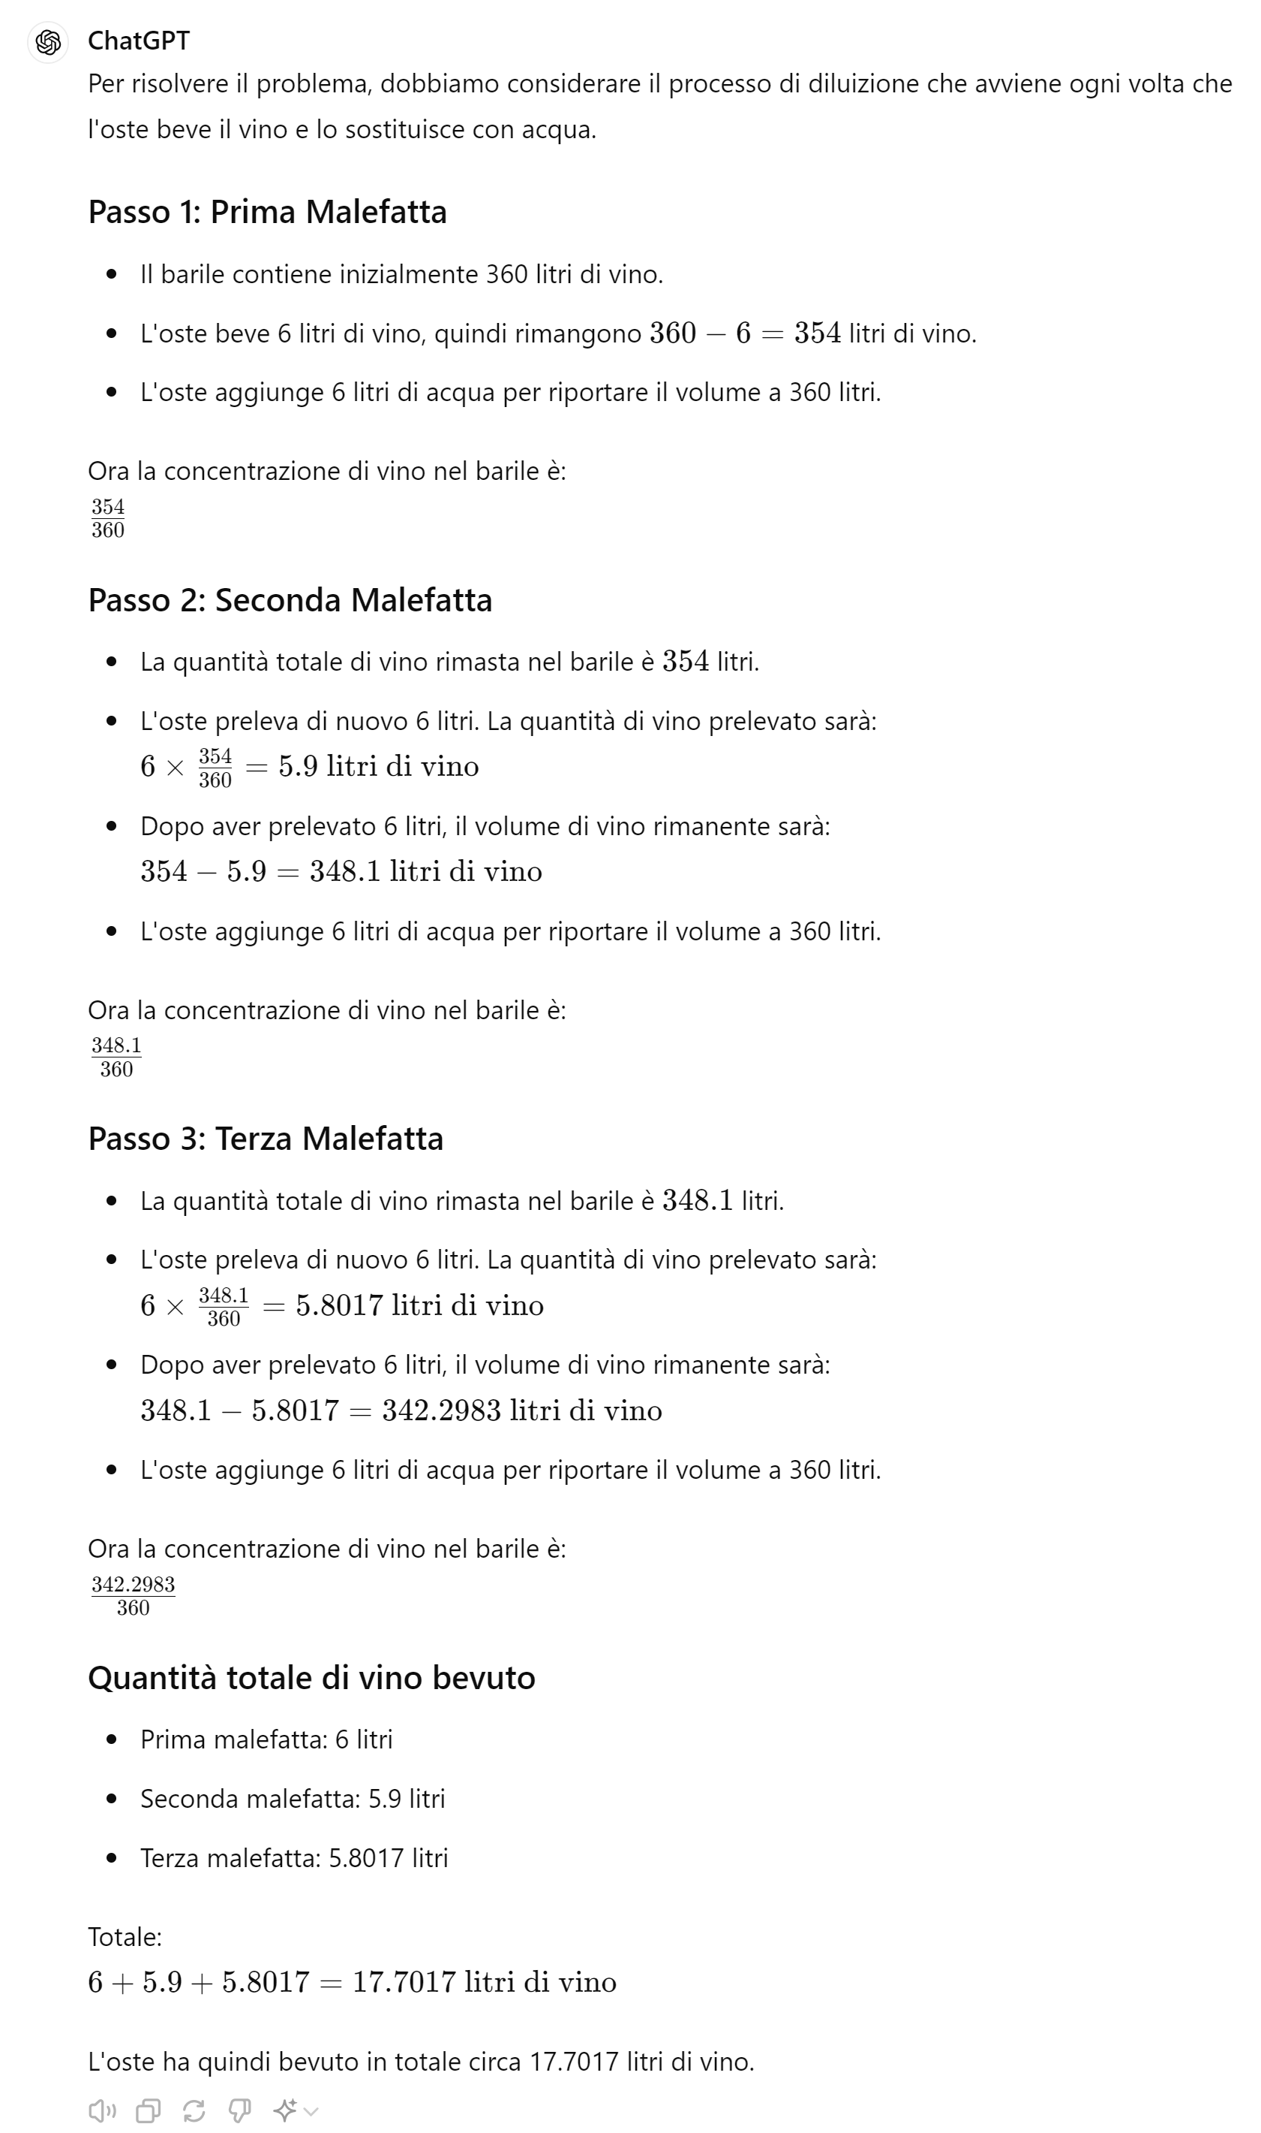
Advanced Problem Solving: Logical Riddles 3

Slide 24
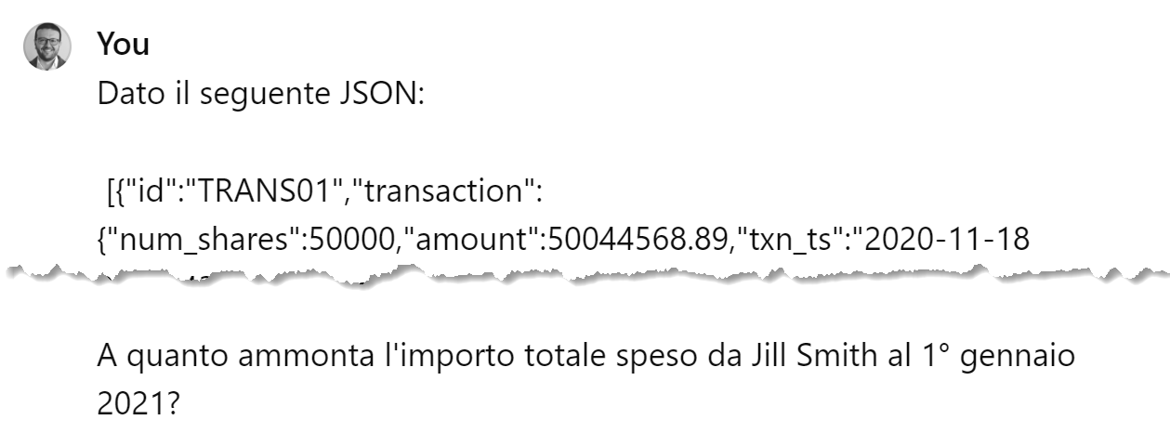
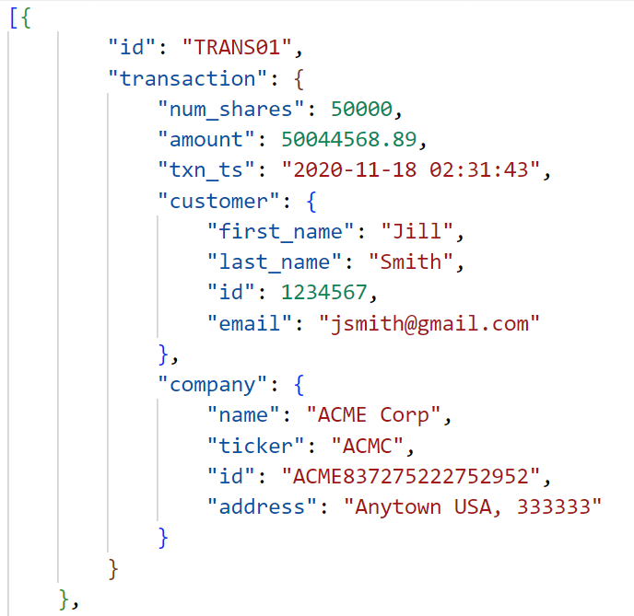
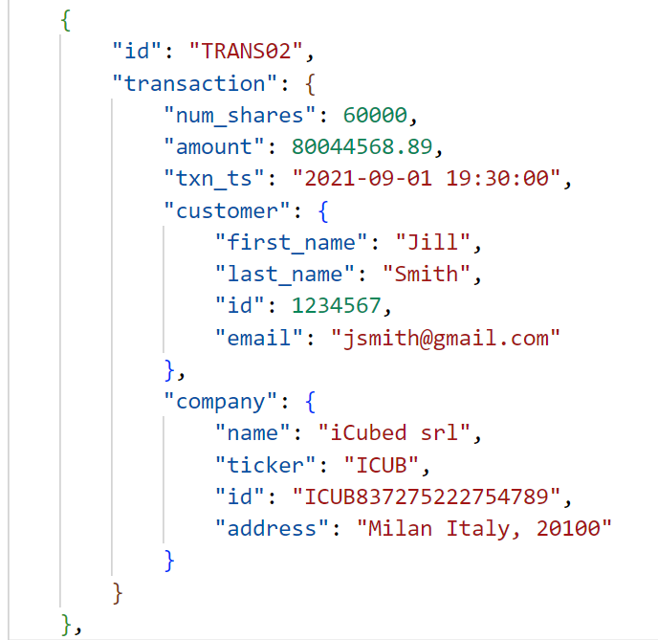
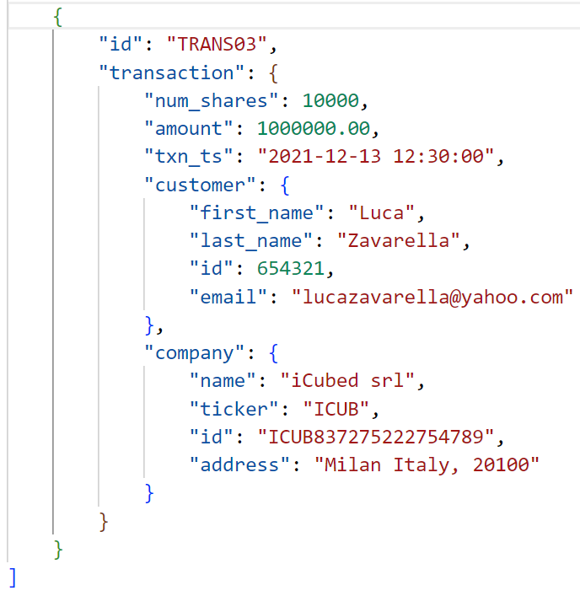
Advanced Problem Solving: Structured Data 1

Slide 25
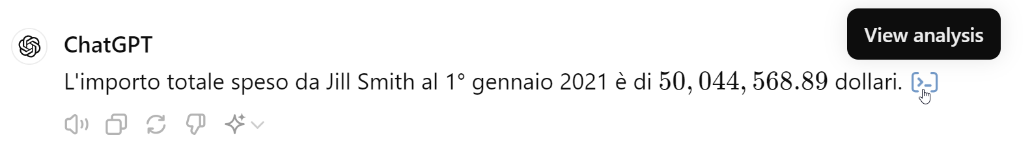
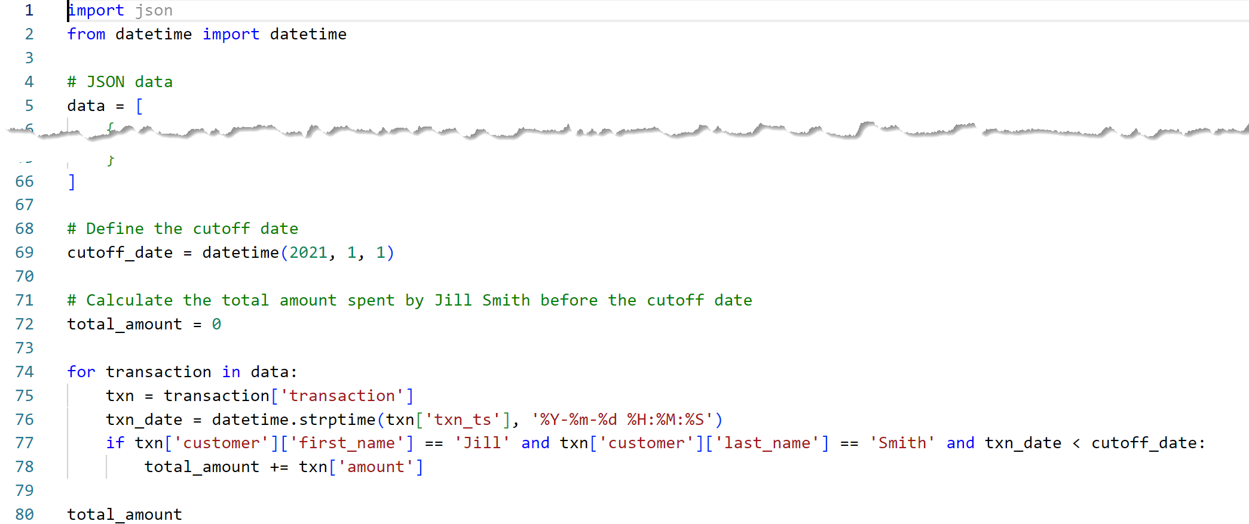
Advanced Problem Solving: Structured Data 2

Slide 26
Theory of Mind
Theory of Mind (ToM): The ability to understand and attribute mental states to others (crucial role in human social interactions, communication, empathy, self-consciousness, and morality)
GPT-3 Milestones
GPT-3 solves around 40% of false-belief tasks
Comparable to 3.5-year-old children
GPT-3.2 achieves 70% accuracy
Comparable to six-year-olds
GPT-3.5 astounding 90% accuracy
Comparable to seven-year-olds
Breakthrough GPT-4
GPT-4 achieves a remarkable milestone by solving nearly all false-belief tasks (95%) 🤯
Suggests a potential emergence of ToM, previously considered uniquely human, in language models
It usually takes 9 years for a human being to achieve this state of social comprehension. AI has achieved it in just 3 years! 🤯

Slide 27

Be Aware To Hallucinations!
ChatGPT operates as a stochastic generative AI model
Its responses are probabilistic in nature
It may not always provide accurate responses to specific queries
It does not understand the meaning behind the content it generates, so responses may occasionally be irrelevant or nonsensical → hallucinations

Slide 28
Unlocking Business Potential with Prompt Engineering

Slide 29

Prompt Engineering: Enhancing AI Interactions
Essence: Tailoring prompts to improve AI's response accuracy and relevance
Goal: Facilitate precise human-AI communication
Key Strategies
Clarity: Use direct, specific prompts
Context: Include relevant background information
Iteration: Refine prompts based on AI feedback
Experimentation: Test various prompt styles

Slide 30
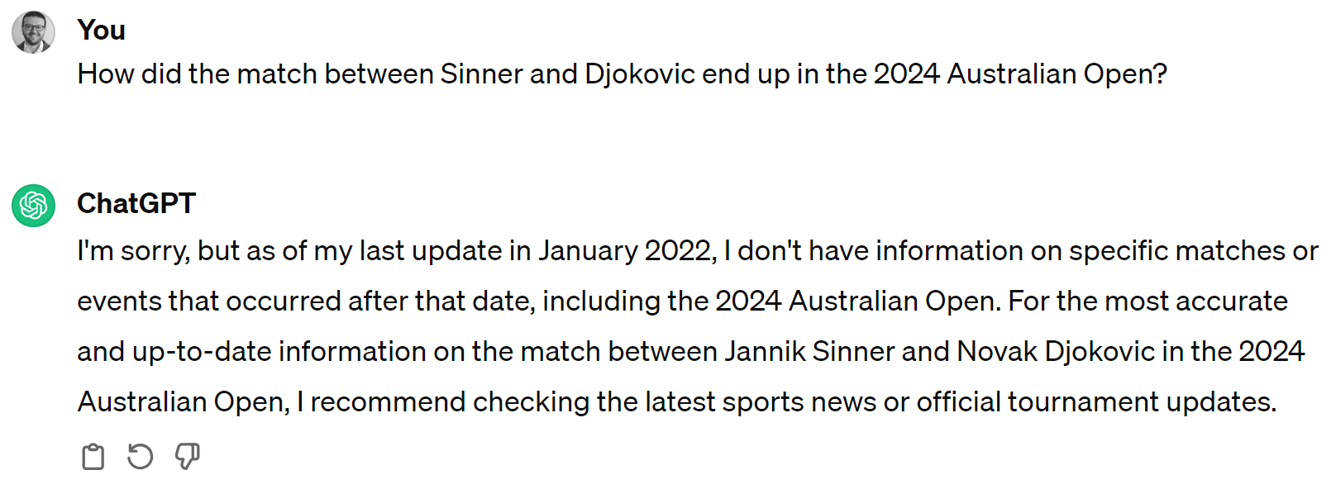
Asking For Recent Information (no Browser)
Notes:
How did the match between Sinner and Djokovic end up in the 2024 Australian Open?

Slide 31
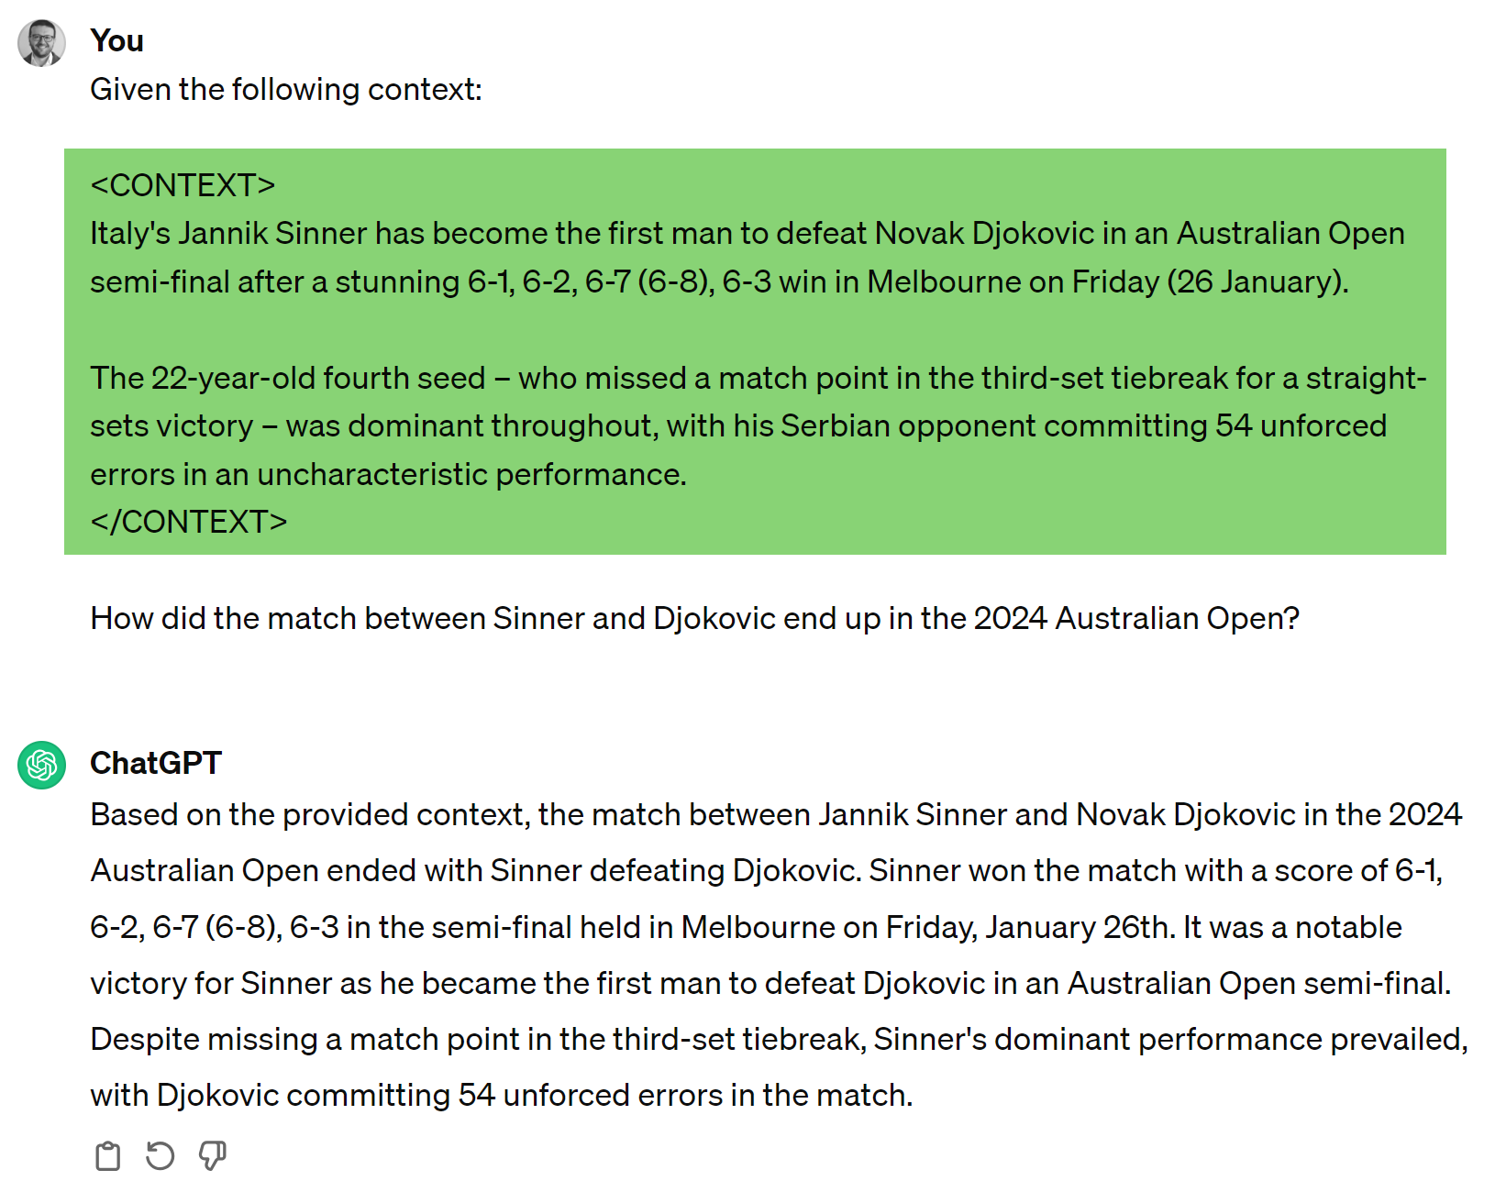
Injecting Context Into Prompts 1
Notes:
Given the following context:
<CONTEXT>
Italy's Jannik Sinner has become the first man to defeat Novak Djokovic in an Australian Open semi-final after a stunning 6-1, 6-2, 6-7 (6-8), 6-3 win in Melbourne on Friday (26 January).
The 22-year-old fourth seed – who missed a match point in the third-set tiebreak for a straight-sets victory – was dominant throughout, with his Serbian opponent committing 54 unforced errors in an uncharacteristic performance.
</CONTEXT>
How did the match between Sinner and Djokovic end up in the 2024 Australian Open?

Slide 32
Injecting Context Into Prompts 2
Notes:
Given the following context:
<CONTEXT>
Italy's Jannik Sinner has become the first man to defeat Novak Djokovic in an Australian Open semi-final after a stunning 6-1, 6-2, 6-7 (6-8), 6-3 win in Melbourne on Friday (26 January).
The 22-year-old fourth seed – who missed a match point in the third-set tiebreak for a straight-sets victory – was dominant throughout, with his Serbian opponent committing 54 unforced errors in an uncharacteristic performance.
</CONTEXT>
How did the match between Sinner and Djokovic end up in the 2024 Australian Open?

Slide 33
Injecting Context About Enterprise
ENTERPRISE DATA
QUESTION ABOUT ENTERPRISE DATA
Notes:
Given the following context:
<CONTEXT>
Italy's Jannik Sinner has become the first man to defeat Novak Djokovic in an Australian Open semi-final after a stunning 6-1, 6-2, 6-7 (6-8), 6-3 win in Melbourne on Friday (26 January).
The 22-year-old fourth seed – who missed a match point in the third-set tiebreak for a straight-sets victory – was dominant throughout, with his Serbian opponent committing 54 unforced errors in an uncharacteristic performance.
</CONTEXT>
How did the match between Sinner and Djokovic end up in the 2024 Australian Open?

Slide 34
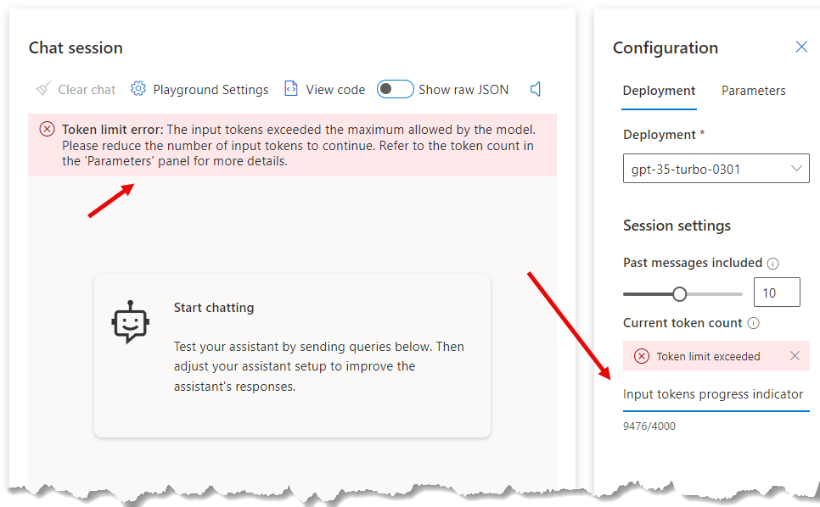

Why Not Drop Everything Into a Prompt?
I have a knowledge base of several GB that I can query with ChatGPT.
I put everything in the prompt as context and that’s it!

Slide 35
Document Knowledge Exploration with GPTs

Slide 36
RAG Framework

Slide 37
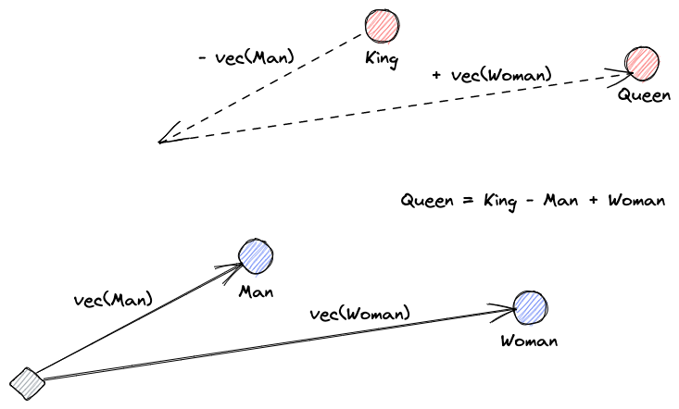
What Are Vector Embeddings?
A neural network learns to transform text to a vector space that contains their actual meaning
This is more useful because it can find synonyms and the syntactic and semantic relationships between words.

Slide 38
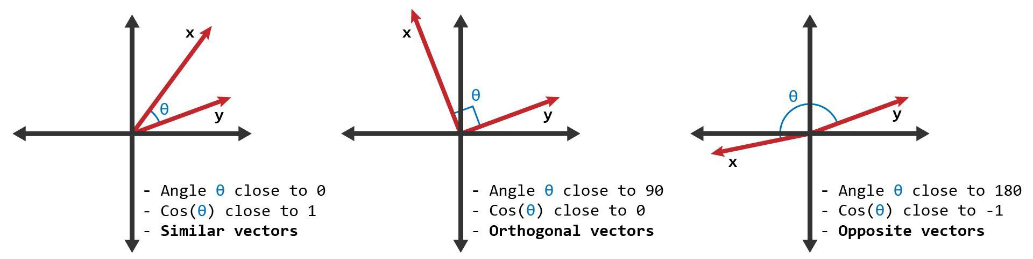
Cosine-Similarity Search

Slide 39
DEMO 1
Play with “Azure AI on Your Data”

Slide 40
References
Theory of Mind Might Have Spontaneously Emerged in Large Language Models (https://arxiv.org/abs/2302.02083)
Prompt Engineering Guide (https://www.promptingguide.ai/)
Azure OpenAI on your data (https://learn.microsoft.com/en-us/azure/ai-services/openai/concepts/use-your-data)

Slide 41
THANK YOU!! ☺

